Slide 1
When deep learning meets object detection: Introduction to two technologies: SSD and YOLO
Wenchi Ma

Slide 2
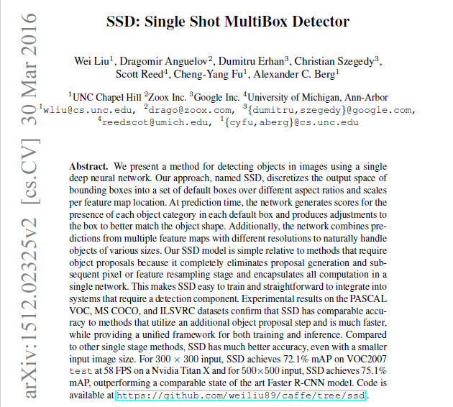

Slide 3
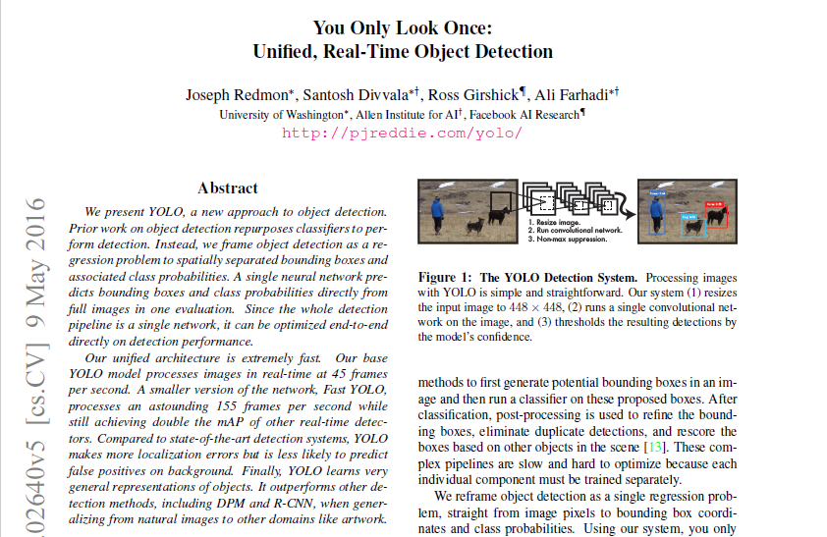

Slide 4
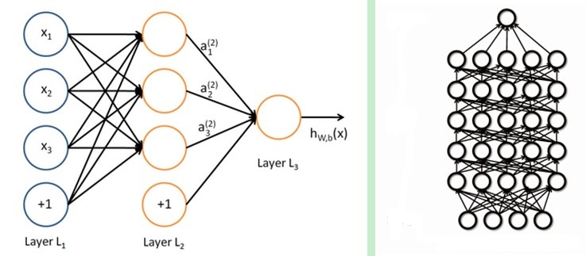
Deep neural network
the name we use for “stacked neural networks”
that is, networks composed of several layers.
Neural network to deep learning
output
layer
input

Slide 5
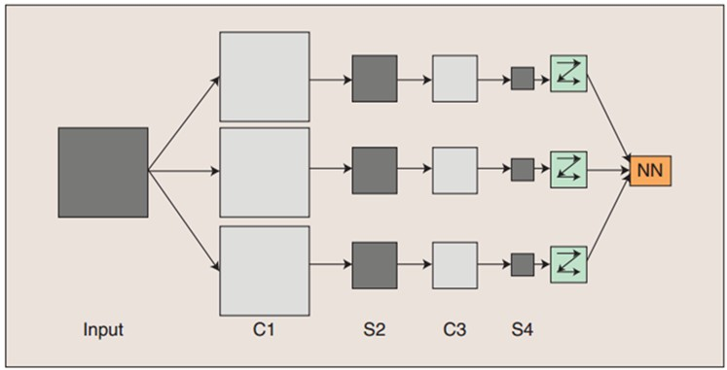
Deep neural network
the name we use for “stacked neural networks”
that is, networks composed of several layers.
Typical example: CNN

Slide 6
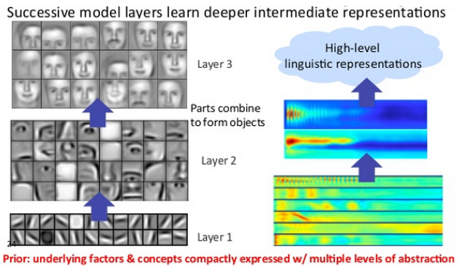
Advantage: able to recognize more complexed features

Slide 7
SSD: Single Shot MultiBox Detector
Tool?-- A single deep neural network
Framework?– Caffe
Technology background?--related methods are structure-complicated and hard to bring high speed and good accuracy
Solution and Advantages:
Providing a unified framework
much faster
better accuracy, even with a smaller input image size

Slide 8
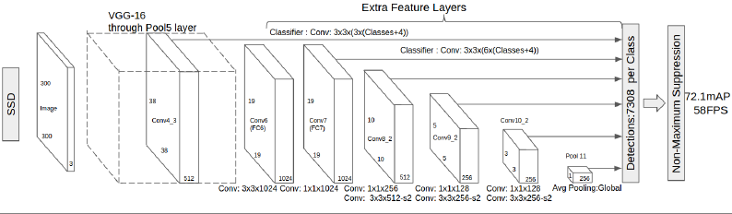
How SSD gets its goal?
For speed: structure advantage!
Eliminating bounding box proposals and subsequent pixel or feature resampling stage
Adding convolution feature layers to the end of the tructed base network to predict detections at multiple scalaes

Slide 9
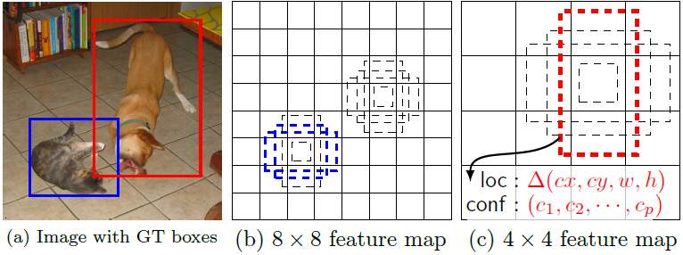
What do convolution feature layers do?
Needs an input image and ground truth boxes for each object during training
Evaluate a small set(e.g.4)of default boxes of different aspect ratios at each locations in several feature maps with different scales.
Filters match these default boxes to the ground truth boxes and predict both the shape offsets and confidence for all object categories for each default box
The feed-forward convolutional network produces a fixed-size collection of bounding boxes and scores for the presence of object class in those boxes

Slide 10

SSD overcoming the influence of resolution difference

Slide 11
Quantity choice
Imposing different aspects ratios for the default boxes, and denote them as :
Instead of using all the negative examples, SSD sorts them using the highest confidence for each default box and pick the top ones so that the ratio between the negatives and positives is at most 3:1——leading to faster optimization and more stable training

Slide 12
Quantity choice
--The overall objective loss function is a weighted sum of the localization loss and the confidence loss(conf)
--N: the number of matched default boxes
--l: predicted boxes
--g: the ground truth box
--x=1 denotes some certain default box is matched to a ground truth box

Slide 13
DATA
Experiments are based on VGG16, which is pre-trained on the ILSVRC CLS-LOC datasets
Training: VOC2007 trainval+VOC2012trainval(16551 images)
Testing: VOC2007 test and VOC2012 rexpectively (4952 images)
Using learning rate for 40K iterations then and continue training for another 20k iterartions

Slide 14
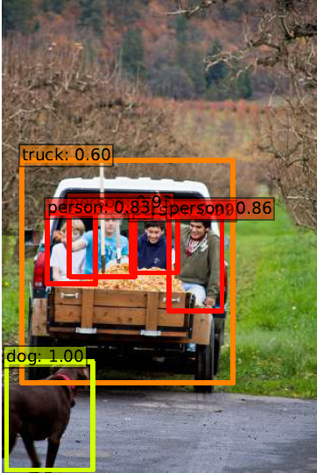
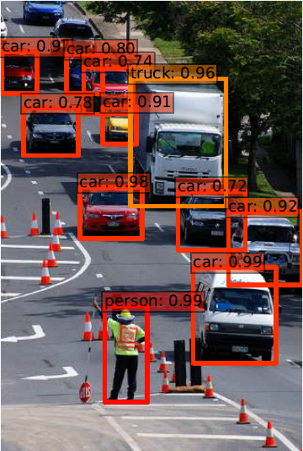

Slide 15
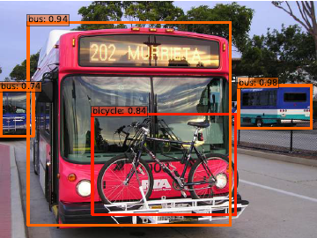
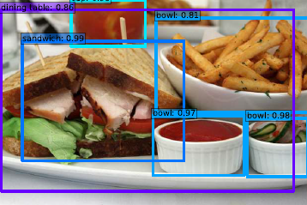
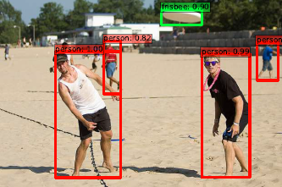
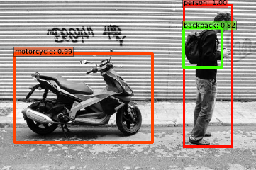

Slide 16
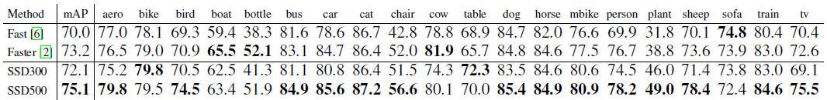
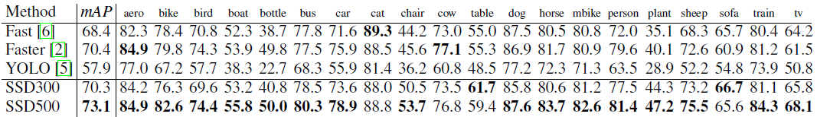
Detection Analysis ——PASCAL VOC 2007test and PSCAL VOC 2012 test
SSD can detect various object categories with high quality.
The majority of its confident detections are correct.
The recall is around 85-90%
Compared to R-CNN, SSD has less localization error
However, SSD has more confusions with similar object categories (as SSD shares locations for multiple categories)
500: training and testing image size
Better than YOLO: maybe due to the use of convolutional default boxes from multiple feature maps

Slide 17
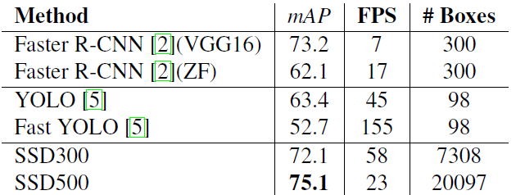
Detection Analysis ——Results on Pascal VOC2007 test
Faster R-CNN uses extra prediction layers for region proposals and requires feature resampling
SSD500 outperforms Faster R-CNN in both speed and accuracy
Fast YOLO can run at 155FPS, but has much lower accuracy by almost 20% mAP
SSD actually make a balance between accuracy and speed compared to Faster R-CNN

Slide 18
YOLO You Only Look Once: Unified, Real-Time Object Detection
Tool?-- A single neural network, unified architecture
Framework?– Darknet
Technology background?--related methods are slow , not real-time and devoid of generalization ability
Solution and Advantages:
Simpler structure of network
much more faster, even with real-time property: 150fps: able to process streaming video in real-time with less than 25 milliseconds of latency
Maintaining a proper accuracy range

Slide 19
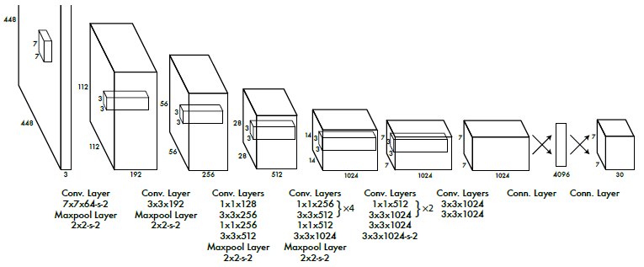
How YOLO gets its goal?
For speed: Also! structure advantage!
No bounding box proposals and subsequent pixel or feature resampling stage
A neural network predicts bounding boxes and class probabilities directly from full images in one evaluation

Slide 20
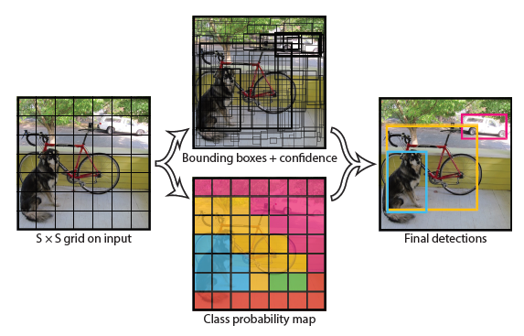
How unified detection works?
uses features from the entire image to predict each bounding box
predicts all bounding boxes across all classes for an image simultaneously?
divides the input image into an s*s grid. If the center of an object falls into a grid cell, the cell is responsible for detecting that object.
each grid cell predicts B bounding boxes and confidence scores for those boxes
Each grid also predicts C conditional(conditioned on the grid cell containing an object) class probabilities

Slide 21
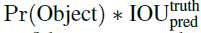
How unified detection works?
confidence scores: reflect how confident is that the box contains an object+how accurate the box is .
conditional class probabilities: conditioned on the grid cell containing an object

Slide 22
How unified detection works?
At test time, multiply the conditional class probabilities and the individual box confidence predictions
giving class-specific confidence scores for each box
Showing both the probability of that class appearing in the box and how well the predicted box fits the object

Slide 23
DATA
Pretraining convolutional layers on the ImageNet 1000-class competition dataset
Training data: VOC 2007 and 2012
135 epochs on the training
Learning rate from to

Slide 24
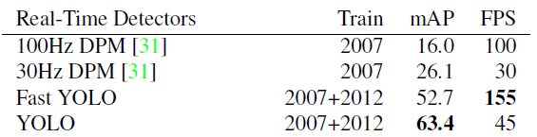
Detection Analysis ——PASCAL VOC 2007test
Fast YOLO is the fastest object detection method on PASCAL; With 52:7% mAP, it is more than twice as accurate as prior work on real-time detection
YOLO pushes mAP to 63:4% while still maintaining real-time performance

Slide 25
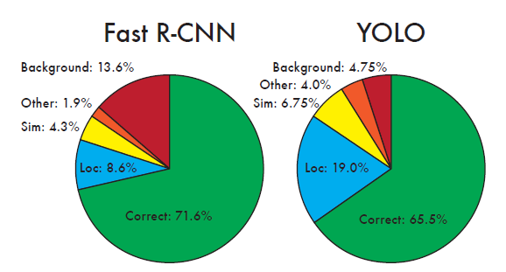
Detection Analysis ——PASCAL VOC 2007test
Better ability to eliminate background error(sees the entire image during training and testing)
Struggle to localize objects correctly(each grid cell only predicts two boxes and can only have one class)

Slide 26
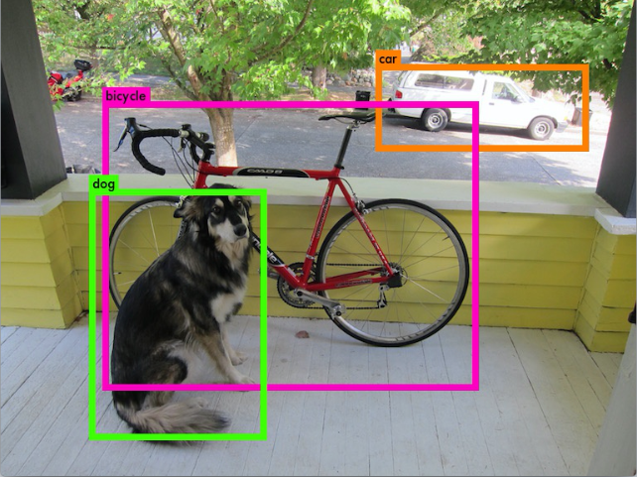

Slide 27
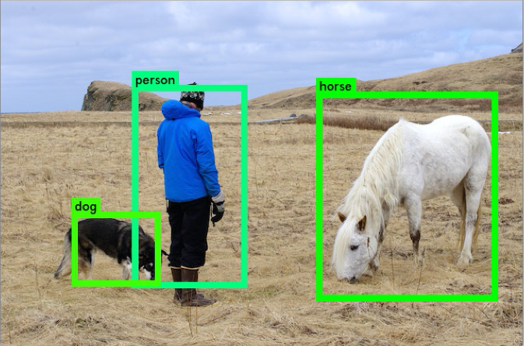

Slide 28
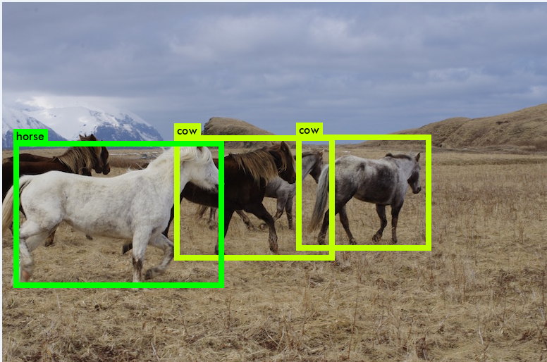

Slide 29
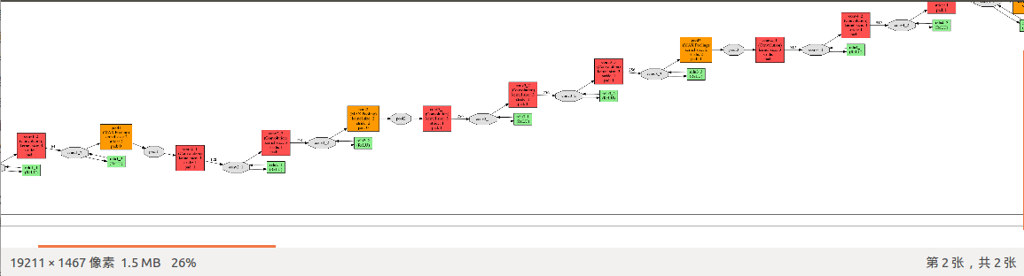
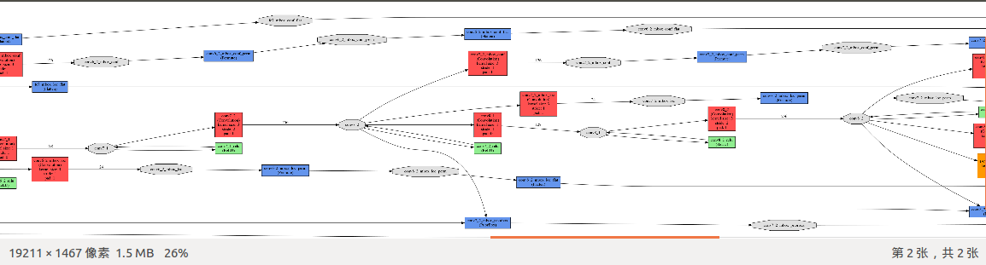

Slide 30
Improvement
YOLO: (1)make each cell predict more bounding boxes
(2)also put the idea of multi-scale into it in order to process small objects
Features
SSD: simplify its structure and speed up

Slide 31
Thank you!

